Slide 1
Module 3 LEARNING STRATEGIES
When planning for a year, plant corn.
When planning for a decade, plant trees.
When planning for life, train and educate people.
Chinese Proverb, Guanzi (c. 645 BC)
Notes:
1. Chinese Proverb - quotation.
2. Content of this Module – (DLP Material Development)
3. – 5. 1. REVISION: A Definition of Knowledge from last DLP Module (Methodology and Didactics) – “What is knowledge?”
6.- 13. 2. QUESTION: What is education? Cognitive Intelligence (CI) and Emotional Intelligence (EI) = Definition. What should survive? 1) Attitudes 2) Values 3) Competences 4) MY Knowledge We will concentrate on 3) Competences and 4) MY knowledge. CI is, of course, important but it cannot be everything – we are not “filling pails”.
14.- 16. 3. QUESTION: What is intelligence? CI, EI and MI (the 8 types of intelligences accord. Prof Gardner, Harvard).
17. – 28. 4. QUESTION: Which competences do students need and how can we help? The 5 ‘Being’ Competences and ‘EUREKA’ Moments (Research by Prof. Sheth, Houston). The Archimedes Syndrome – The Magic of Creativity.
29. – 34. 5. DISCUSSION: Different ways of learning and the consequences for our teaching. The “Golden Triangle” – Learning – Learner – Teaching. There must be a harmony between these three. To be taken into consideration: content vs. skills & serial vs. global.
35. Summary of the consequences for our teaching – we have to keep in mind: 1) Knowledge and Education 2) Intelligences 3) Competences 4) Learning/Learner 5) Creativity - And we have to constantly think of the excitement of ‘EUREKA’ Moments.
36. – 52. 6. TASK: Analysing/Developing DLP material The Teaching Experience – The Filter Effect – The Three Types of DLP Materials – 6 DLP Material Analysis/Development Principles – Boops (General Science) – Surprise (Physics - The Rainbow Experiment) – Oceans and Seas (Biology - Habitat: River) – Chinese Whispers <started with Chinese and will end with Chinese> (History The Hunters)

Slide 2
…and the question is always: “What is the purpose?” “Why”
0
1
Listening
Listening
Reading
Speaking
Speaking
Writing
Writing
Reading
L…R…S…W
L…S…W…R

Slide 3
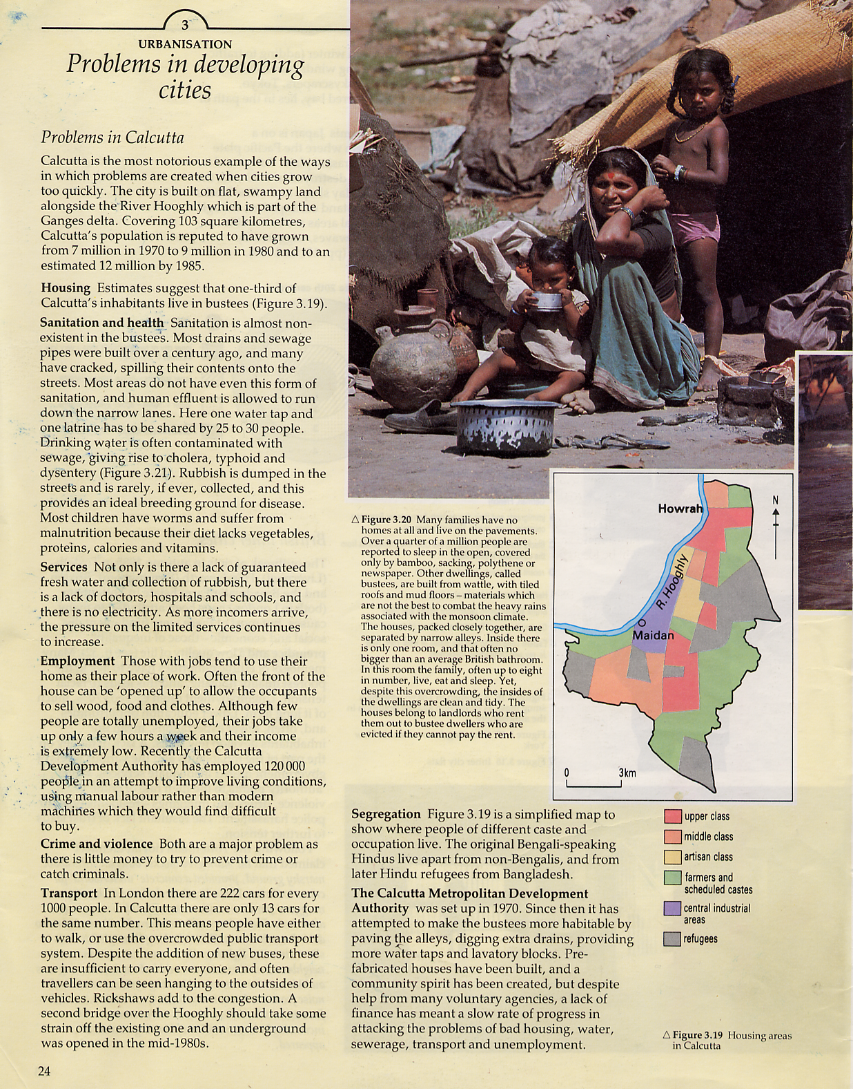
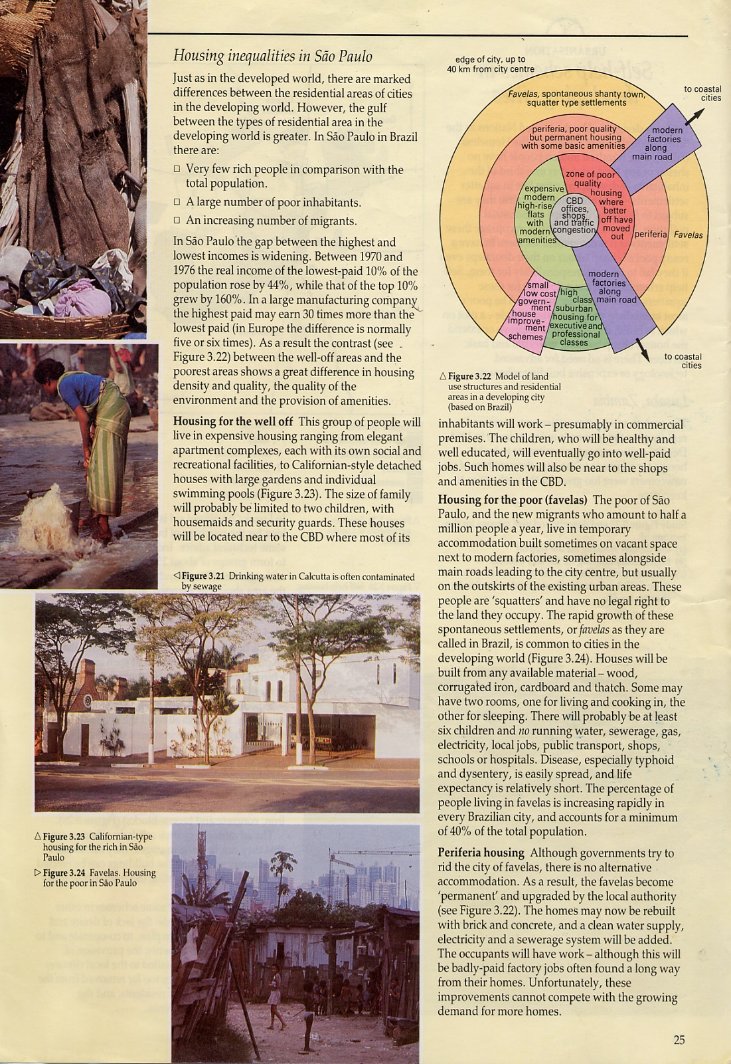
THE CHALLENGES OF READING
1) Too much text (Language of Input)
2) Lack of structure (Hierarchy of Information)
3) Difficult vocabulary
4) …
Notes:
EUROPA BÜRO
READING STRATEGIES FOR DLP

Slide 4
Level 1: Title
Level 2: Sub-title(s)
Level 3: Heading(s)
Level 5: Topic Sentences
Level 4: Sub-heading(s)
Page Layout Conventions

Slide 5
Hierarchy of Information
Level 1: TITLE
URBANISATION
Level 2: SUB-TITLE(S)
Problems in developing cities
Level 3: HEADING(S)
Problems in Calcutta / Housing inequalities in Sao Paulo
Level 4: SUB-HEADING(S)
Housing / Sanitation and Health …
Level 5: TOPIC SENTENCES
Calcutta is the most notorious example …

Slide 6
SQ3R Reading Strategies
S = survey the document, title, subtitles, headings, sub-headings, topic sentences...
Q = question – e.g. “What do I want to find out from the text?”
R = read - there are different types of reading, the three most common types: skimming, scanning, reading in detail
R = recall - “What was the text about?”
R = review - look back over the text; answer the question you asked yourself

Slide 7
SQ3R Different types of reading
SCAN = find a particular piece of information in the text.
SKIM = get an overview of the text
EXACT = find out details and special information

Slide 8
SQ3R Skimming
Topic sentence In your own writing, when you move on to a new idea, you start a new paragraph. The topic sentence is usually the first sentence of a paragraph and contains the core information of the paragraph.
Markers - conventions: Examples: “for example”, “such as”, “e.g.” = what is coming next is an illustration of a point already made - “but”, “however”, “on the other hand”, “nevertheless” show that a contrasting idea is being introduced.

Slide 9
SQ3R Skimming
Topic sentences Calcutta is the most notorious example of the ways in which problems are created when cities grow too quickly. Estimates suggest that one-third of Calcutta’s inhabitants live in bustees (Figure 3.19). Sanitation is almost non-existent in the bustees. Not only is there a lack of guaranteed fresh water and collection of rubbish, but there is a lack of doctors, hospitals and schools, and there is no electricity. Those with jobs tend use their home as their place of work. Both are a major problem as there is little money to try to prevent crime or catch criminals. In London there 222 cars for every 1000 people. In Calcutta there are only 13 cars for the same number.
120 words instead of 435 words

Slide 10
Writing Strategies
THE CHALLENGES OF WRITING
1) The empty page
2) Lack of structure and focus: - type of activity - type of text - type of language - organisation of information (Hierarchy of Information)
3) …

Slide 11
Example: Geography
1) Type of Activity
2) Type of Text
3) Type of Language
Planning
(Future) Planning
Future: “I am planning to …”
Reporting
(Past) Reporting
Past: “I discovered that …”
Observing
(Past) Recounting
Past: “I observed …”
Recording Evidence
(Present) Note-taking
Present: “The notes show …”
Drawing Conclusions
(Present) Analysing
Present: “I believe that …”
…
…
…
“WRITING FRAMES” Steve Harrison & Patricia Harrison
© 1999, Belair Publications: E-mail: belair@belair-publications.co.uk

Slide 12
“Guiding Stages”
Type of Language = Writing Frame
I am planning to investigate
1) TOPIC
Type of Activity:
To help my investigation, I will need
(Future) Planning
2) TOOLS
Topic sentences (beginning)
The two most important questions I want to find answers to are
and
Type of Text:
3) LINES OF ENQUIRY
1) Planning text
2) Reporting text
3) Recounting text
I expect to discover that
4) Note-taking text
5) Analysing text
4) EXPECTATION
6) … text
Name: Date:

Slide 13
Hierarchy of Information
Headings
1) TOPIC
Name: Class: School:
I am planning to investigate
Author
2) TOOLS
To help my investigation, I will need
Topic Sentences
3) LINES OF ENQUIRY
The two most important questions I want to find answers to are
and
Subject: Title:
Title
4) EXPECTATION
Sub-Title
Sub-title:
I expect to discover that
Ownership
Name and Signature: Date:

Slide 14
“Guiding Stages”
Type of Language = Writing Frame
I discovered that
1) REPORT
Type of Activity:
What surprised me most was
(Past) Reporting
2) OPINION
Topic sentences (beginning)
I was really glad I
because
3) LEARNING EFFECT “+”
Type of Text:
1) Planning text
2) Reporting text
If I were to carry out another investigation, I would not
3) Recounting text
4) Note-taking text
4) LEARNING EFFECT “-”
5) Analysing text
6) … text
Name and signature: Date:

Slide 15
“Guiding Stages”
Type of Language = Writing Frame
The geographical feature I observed was
1) REPORT
Type of Activity:
I did this as part of my work on
2) CONTEXT
(Past) Recounting
The equipment I found really helpful was
Topic sentences (beginning)
3) LEARNING EFFECT “+”
The most interesting thing I learned was
I think this because
Type of Text:
4) FOCUS
1) Planning text
2) Reporting text
3) Recounting text
My observations will help me to
4) Note-taking text
5) LEARNING EFFECT “+”
5) Analysing text
6) … text
Name and Signature: Date:

Slide 16
Hierarchy of Information
Headings
Topic Sentences
1) REPORT
Author
The geographical feature I observed was
Name: Class: School:
the bend of a river.
Stuart Simpson
5a
2) CONTEXT
I did this as part of my work on
Royal High School, Edinburgh
the journey of a river from its source to the sea.
3) LEARNING EFFECT “+”
The equipment I found really helpful was
a cork, a ruler and a stopwatch. I timed the journey of a cork along a measured distance.
4) FOCUS
Title
The most interesting thing I learned was
I think this because
Geography and Environmental Studies
that the water flows faster on the outside of the bend and slower on the inside.
Subject:
Title:
although the cork had to travel a longer distance it was as fast as the cork on the shorter distance which bobbed around slowly.
The flow of a river from its source to its mouth
5) LEARNING EFFECT “+”
My observations will help me to
understand why soil and stones are deposited on the short bend of a river while the river wears away the soil on the long bend.
Sub-Title
Sub-title:
Bends in a river
Name and Signature: Date:
Ownership

Slide 17
“Guiding Stages”
Type of Language = Writing Frame
Place visited: Date:
1) REPORT
Type of Activity:
My sketch of shows
2) EVIDENCE A
(Past) Recounting
The notes I took show
Topic sentences (beginning)
3) EVIDENCE B
Type of Text:
1) Planning text
2) Reporting text
3) Recounting text
I brought back with me
This is useful because
4) Note-taking text
4) EVIDENCE C
5) Analysing text
6) … text
5) REASON
Name: Date:

Slide 18
“Guiding Stages”
Type of Language = Writing Frame
The evidence I have collected consists of
1) REPORT
Type of Activity:
The most important evidence tells me
(Past) Recounting
2) CONCLUSION A
Topic sentences (beginning)
In the light of my evidence, I believe that
Type of Text:
3) CONCLUSION B
1) Planning text
2) Reporting text
I am not sure about
3) Recounting text
4) CONCLUSION C
4) Note-taking text
To be more certain I will need to
5) Analysing text
6) … text
5) PLAN
Name: Date:

Slide 19
Sage on the Stage?
Guide on the side?
1) Identify type of writing activity
“Writing Frames have been shown to assist many students in the structuring of their writing. The intimidating blank piece of paper is replaced by shorter sections introduced by the beginning of a ‘topic sentence’.“
2) Type of writing activity = type of writing = structure of writing frame
3) Identify the different ‘guiding stages’ of the writing frame
4) Structure the beginnings of the ‘topic sentences’ according to the direction you want to guide your students.

Slide 20
Thank you for your kind attention,
Stuart.

